Slide 1

Animal Rescue Website
Project Guide
Prof. Apeksha Mohite
Group Members | Student ID
Divyal Chheda | 21204005
Sanskruti Rawal | 20104020
Muskan Rao | 20104096
Notes:
‹#›

Slide 2
Contents
Introduction
Objectives
Scope
Literature Survey
Proposed System
Project Outcomes
Block Diagram
Use Case/DFD
Technology Stack
Suggestions in Review-1
Result and Discussion
Conclusion and Future Scope
References
Notes:
‹#›

Slide 3
1. Introduction
Problem Identified :
A lack of public awareness.
Funding is hard to come by.
Solution Proposed :
Donation portal for animal welfare.
Basic first-aid information for animals.
Availability of emergency contact information.
Notes:
‹#›

Slide 4
2. Objectives
To enhance the positive and professional image of animal
welfare and control agencies.
To protect and care for the suffering and homeless animals.
To facilitate increased funding for the development,
validation and implementation of animal rescue
alternatives.
To find the solutions for the rescue of animals & birds and
accordingly providing basic needs to them.
Notes:
‹#›

Slide 5
3. Scope
The main scope for this project is limited to the intranet for
time being it is not deployable on any handheld devices.
Also, to provide ease of working towards the welfare of
abandoned, stray, lost, or surrendered pets.
It saves time, paperwork is less and easy retrieval of records.
Automating the system reduces the process of middle man
who takes a commission.
Notes:
‹#›

Slide 6
4. Literature Survey
Paper 1 : Pet Adoption Website
Author : Randall Dsouza*1, Vijay Vidhrani*2, Siddhi Bhatade*3, Tanaya Kadam*4, Pratibha Pednekar*5
A Pet Adoption Website is a website based on helping pets and providing them a safe place where they can live in peace and get the love and support. It helps the pets to have a new life where he can be happy. Animal adoption in India is usually done by buying dogs/cats from Pet shop or buying from the people whose Pets have had babies. There are only a few people that adopt stray Pet. The inspiration of this project may be a Android and iOS Website for people to be more responsive to the stray animals awaiting to urge adopted around India.
Notes:
‹#›

Slide 7
4. Literature Survey
Paper 1 : A New Web-Based Tool for RTO-Focused Animal Shelter Data Analysis
Author : Tom Kremer Minerva Schools at KGI, San Francisco, CA, United States
Animal shelters are increasingly interested in reducing their intake and
helping their communities keep and care for animals. Improving
Return-to-Owner (RTO) rates of stray dogs is one path to save significant
shelter space, time, and costs and keep animals with their caregivers and
communities. Aggregating and visualizing RTO data spatially are useful for
identifying trends and highlighting areas for potential interventions. Shelters
are welcome to use the tool and participate in the development of new
analytical lenses and visualizations that would best suit their needs.
Notes:
‹#›

Slide 8
5. Proposed System
Animal rescue website mainly focuses on adoption & rescue
of pets so we have featured the steps for it.
Also, If any person is willing to donate for pets, we accept
the Donation too.
If any pet is injured, the steps for treatment have been
highlighted in our project.
We also have social media contacts wherein people can
connect with us and can know the things they want to.
Notes:
‹#›

Slide 9
6. Outcome of Project
Admin and user will be able to login.
The admin can add/delete/update animals and their
donations.
The user can donate to all kinds of animal rescue
funds.
The user can also learn about the different events happening around if they wish to be a part of them.
The user can access different blogs to learn about animal rescue and other such rescue programs.
Notes:
‹#›

Slide 10
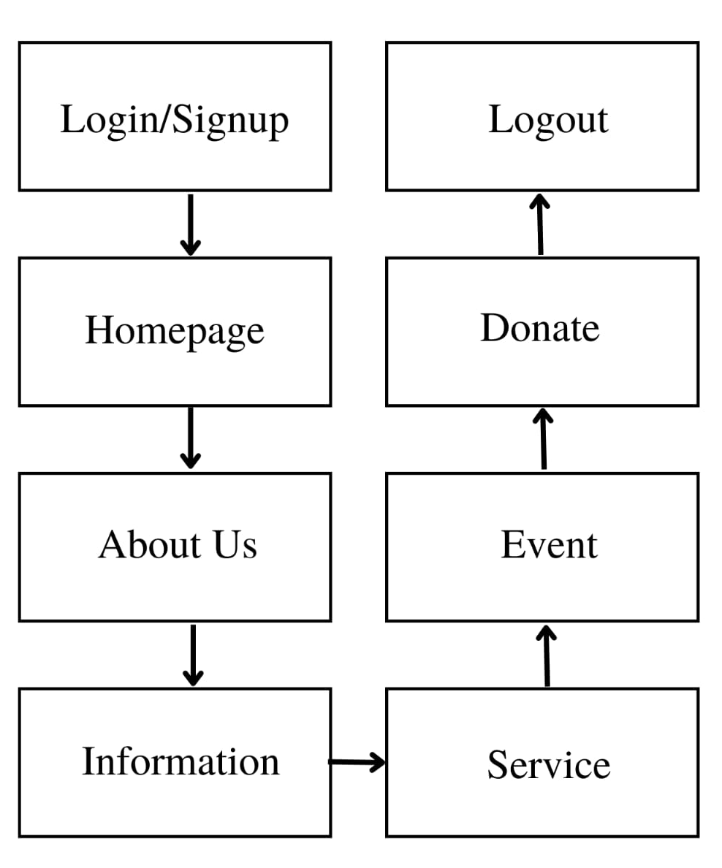
7. Block Diagram
Notes:
‹#›

Slide 11
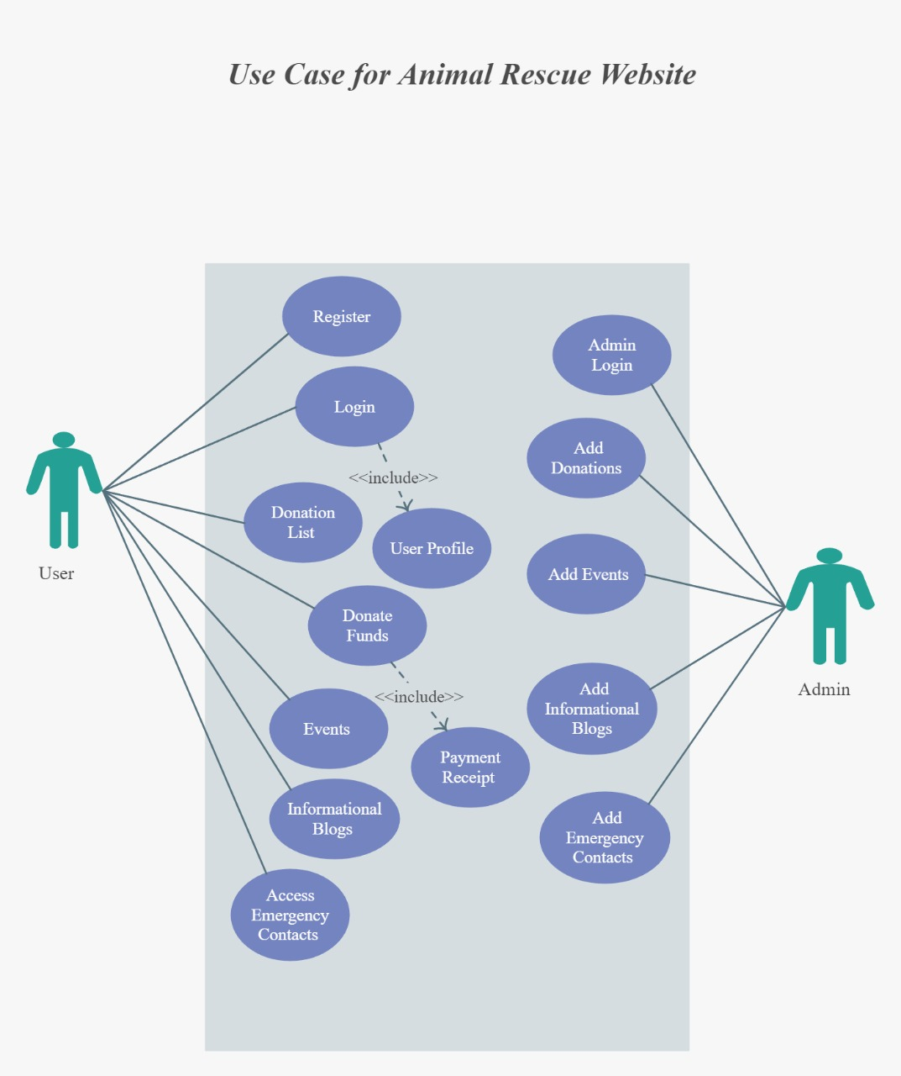
8. Use Case Diagram
Notes:
‹#›

Slide 12
9. Technology Stack
FRONT END – HTML 5
– CSS 3
– JavaScript
– BootStrap
BACKEND – Firebase
EDITOR – VS Code/Brackets
OPERATING SYSTEM – WINDOWS 10
Notes:
‹#›

Slide 13
Suggestions in Review-1
Presentation – Add literature review
Focus on website aesthetics
Homepage – when we login, then at the top right user who has logged in that name should be displayed.

Slide 14
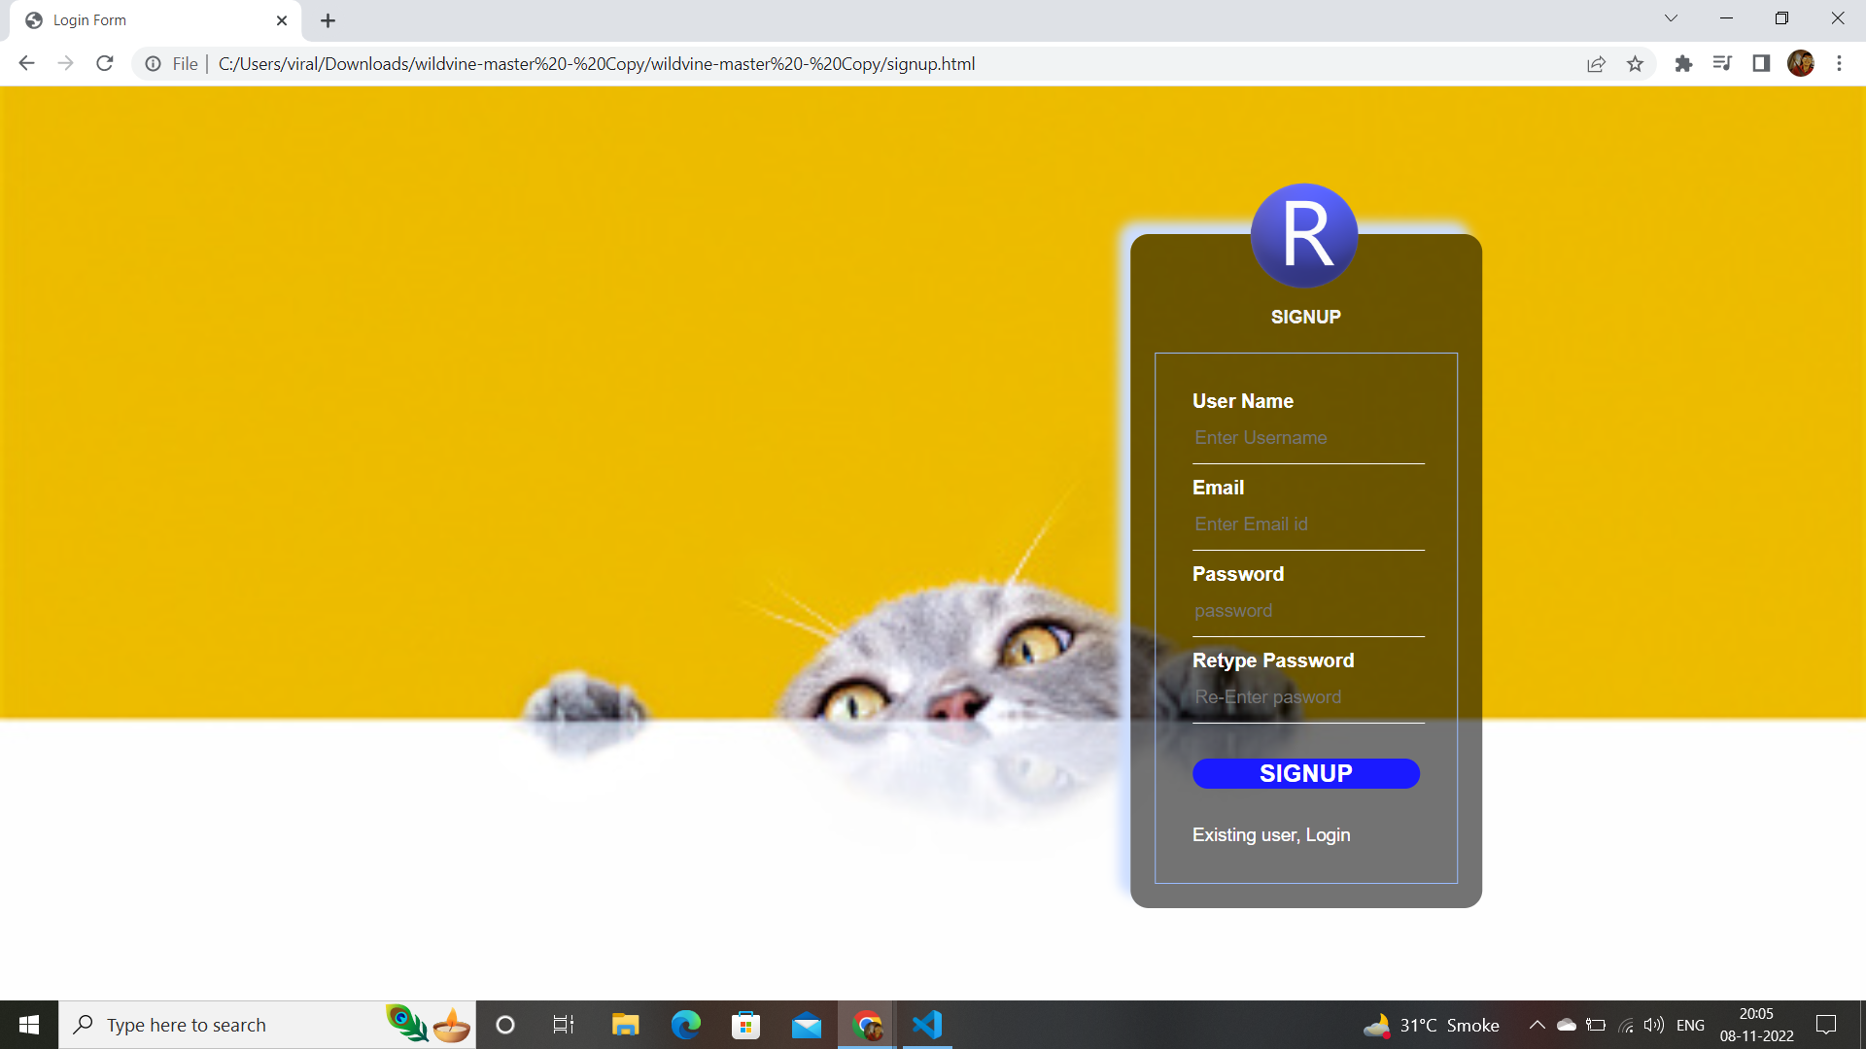
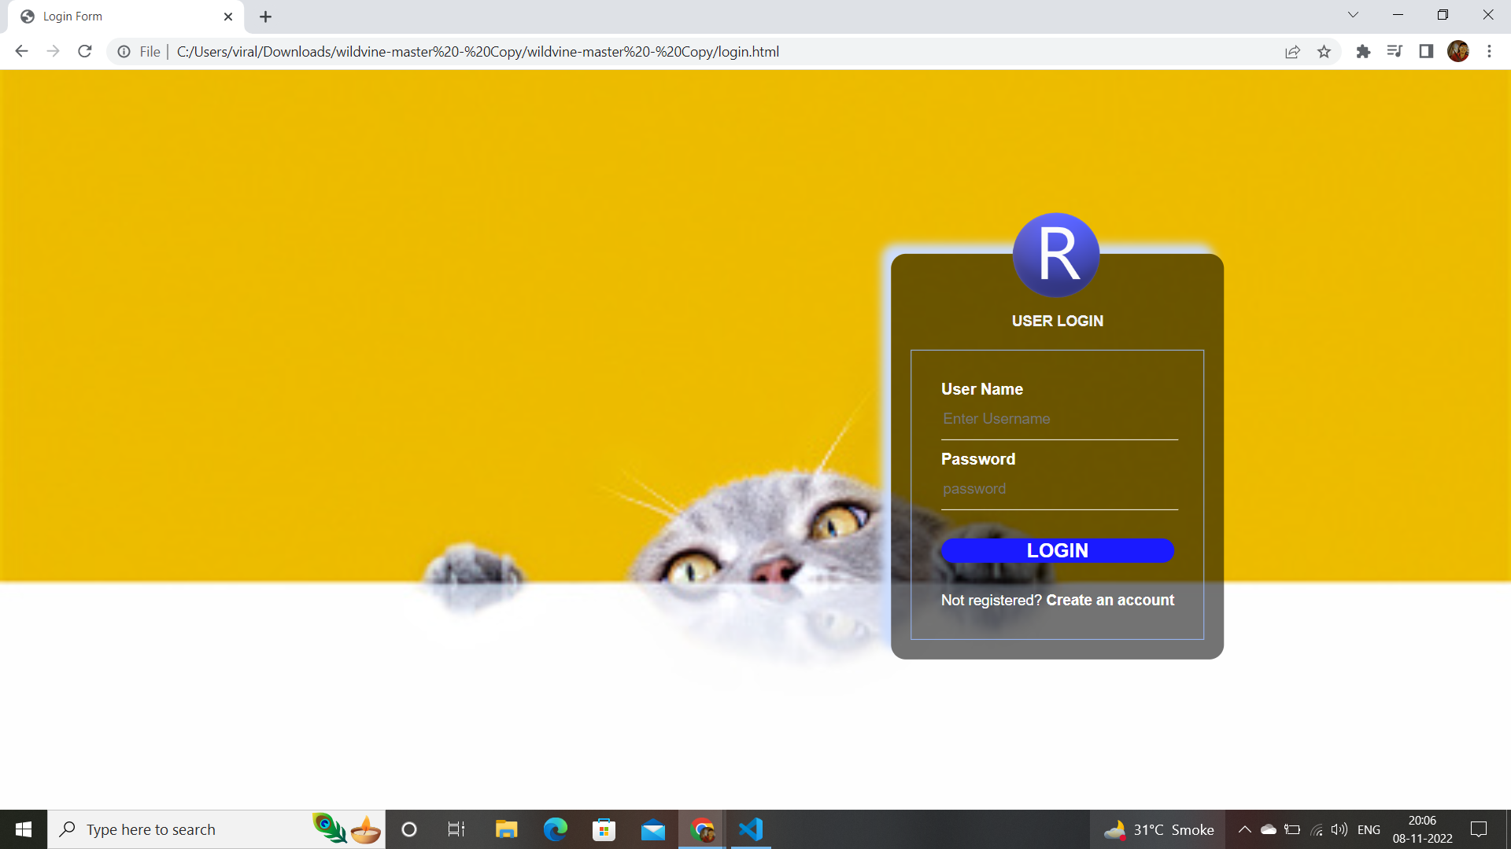
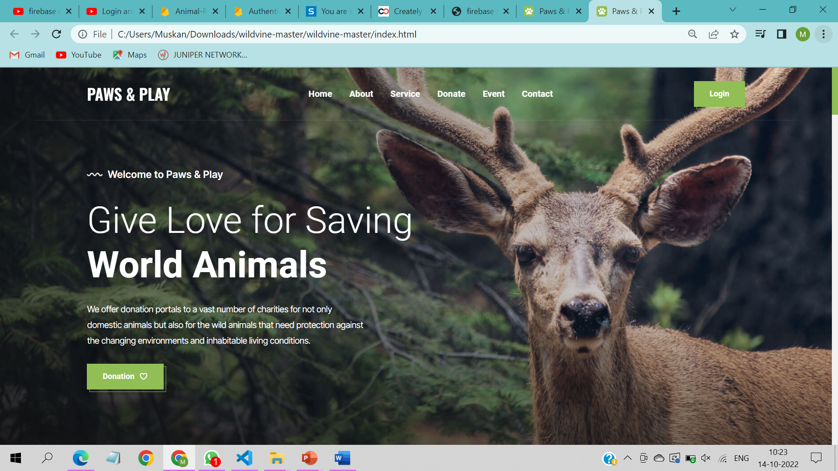
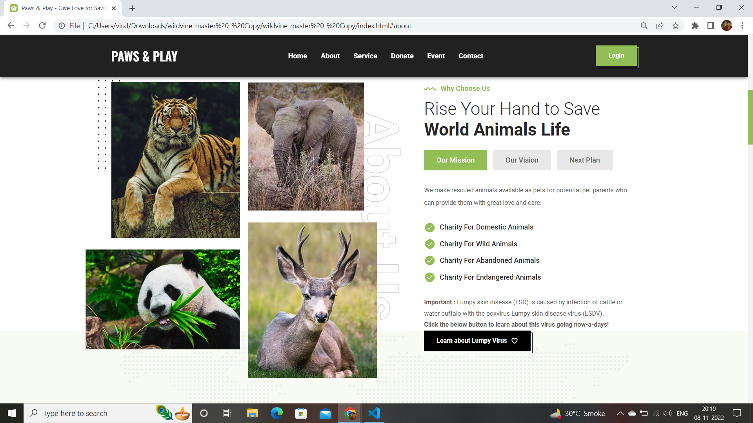
Result and Discussion

Slide 15
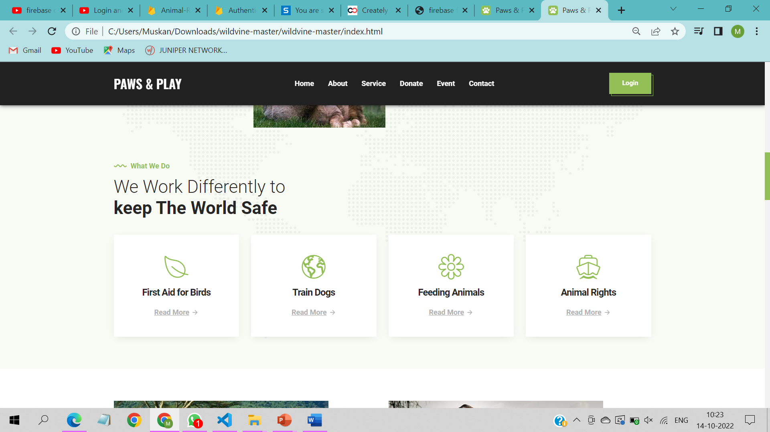
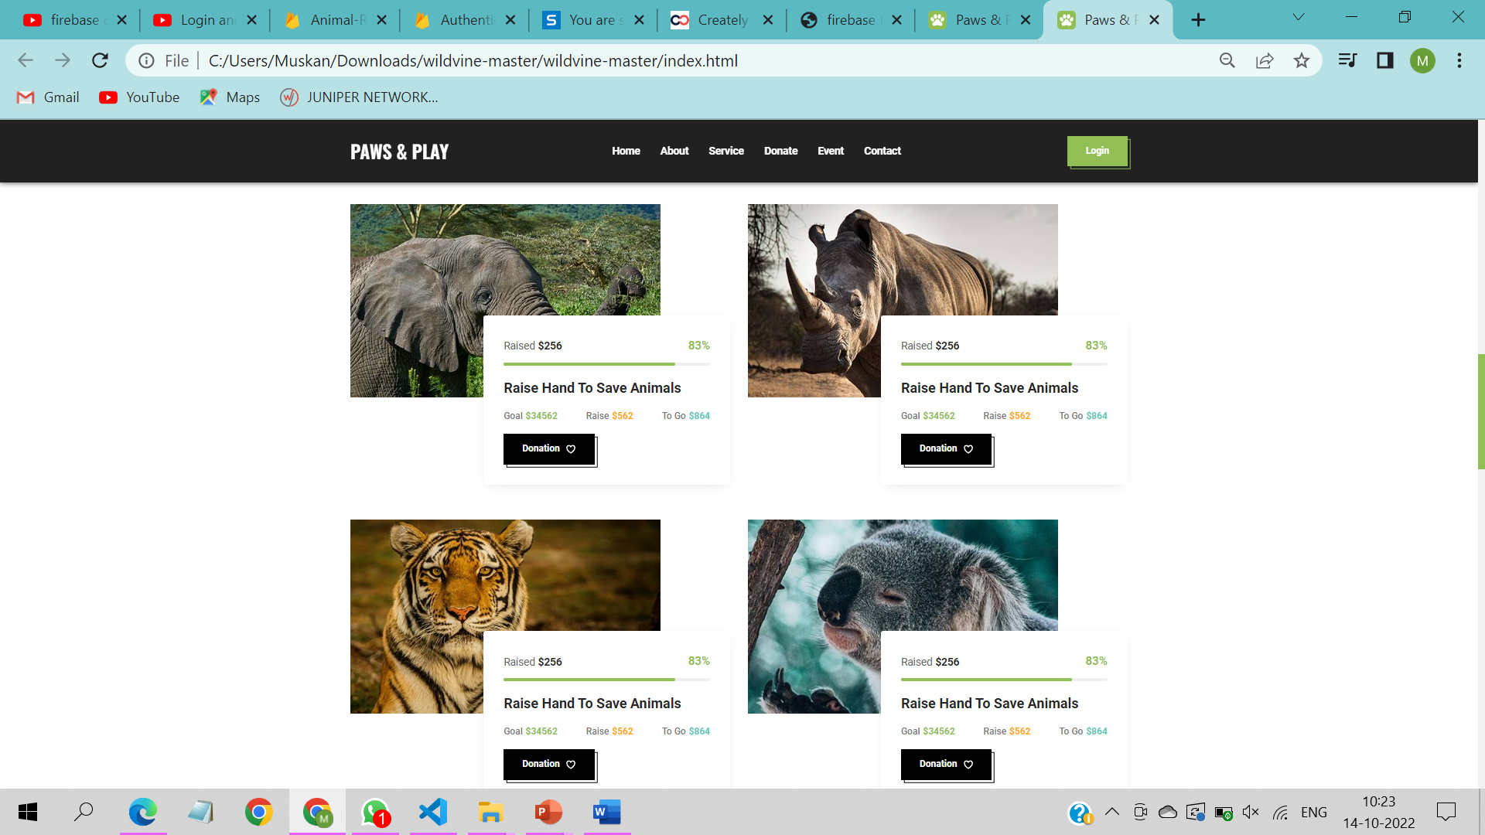
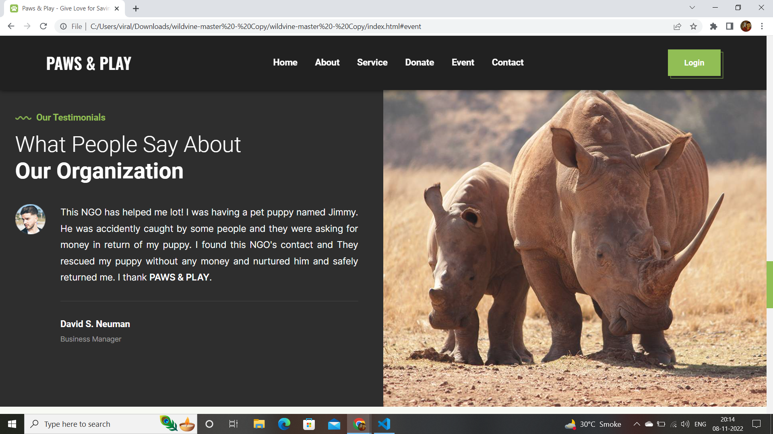
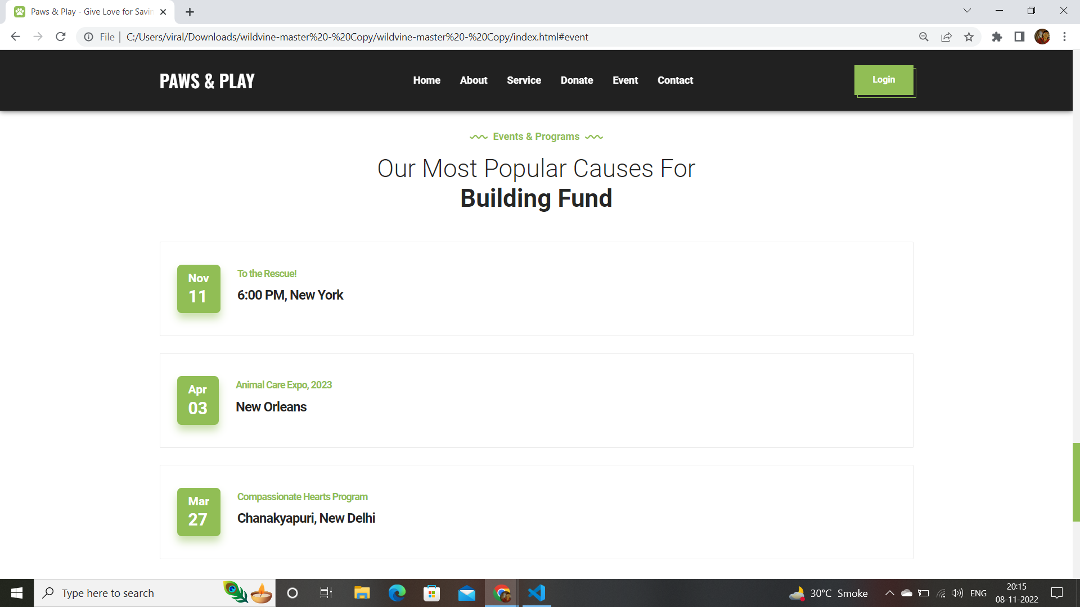
Result and Discussion

Slide 16
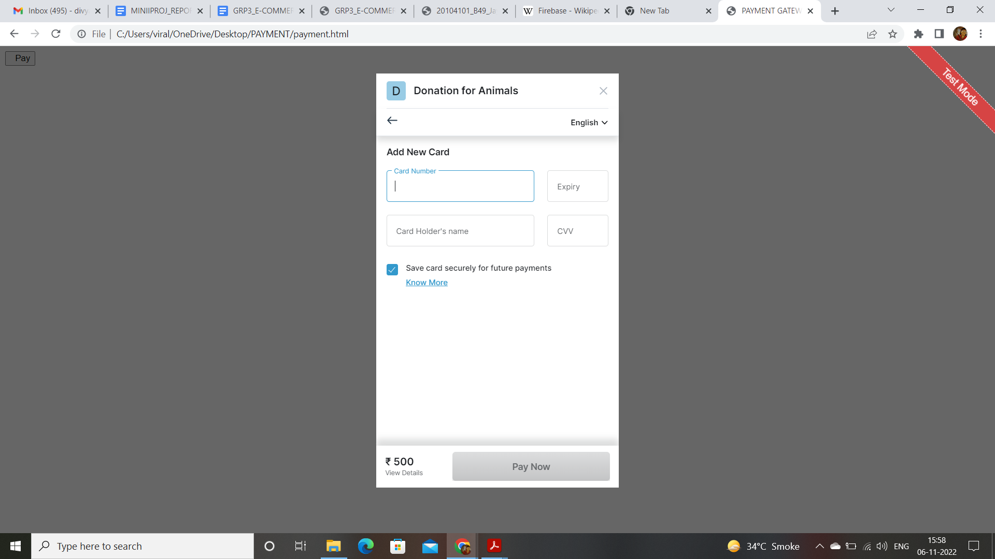
Result and Discussion

Slide 17
Conclusion and Future Scope
Our Animal Rescue Website mainly focuses on Paper less work & it also saves time. Our website also provides ease of working towards the welfare of abandoned, stray, lost, or surrendered pets. The main scope for this project is that it is not deployable on any handheld devices.

Slide 18
References
https://www.irjmets.com/uploadedfiles/paper/issue_4_april_2022/21899/final/fin_irjmets1653142668.pdf
https://www.w3schools.com/html/html_scripts.asp
https://www.ceias.nau.edu/capstone/projects/CS/2017/PetAdoptionTool/docs/SoftwareDesignDocumentFinal.pdf
https://www.frontiersin.org/articles/10.3389/fvets.2021.669428/ full

Slide 19
Thank You...!!
Notes:
‹#›

